Slide 1
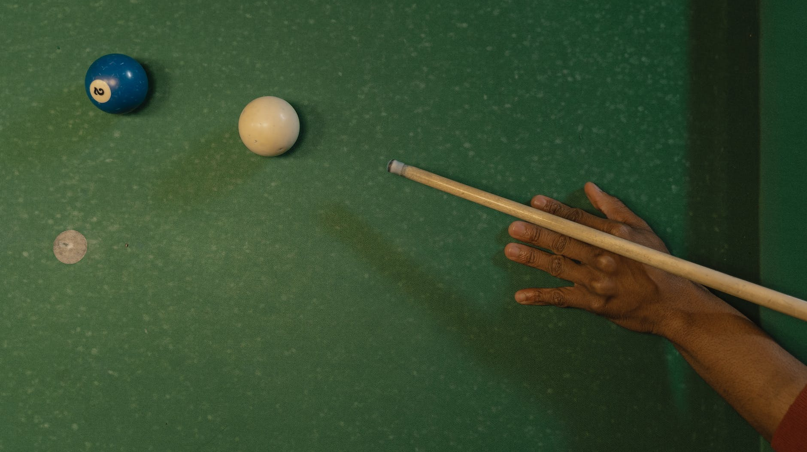
8Ball
Designed by:
Biemmi Andrea
Thomas Argentin

Slide 2

Project Overview
- "8ball" is an online billiards game. The client-server application allows two players to play against each other.
-The client provides a graphical interface to view and interact with the game.
-The server handles the game logic, receives commands from the clients, calculates results, and sends game status updates.
In summary, "8ball" provides an online billiards game experience.

Slide 3

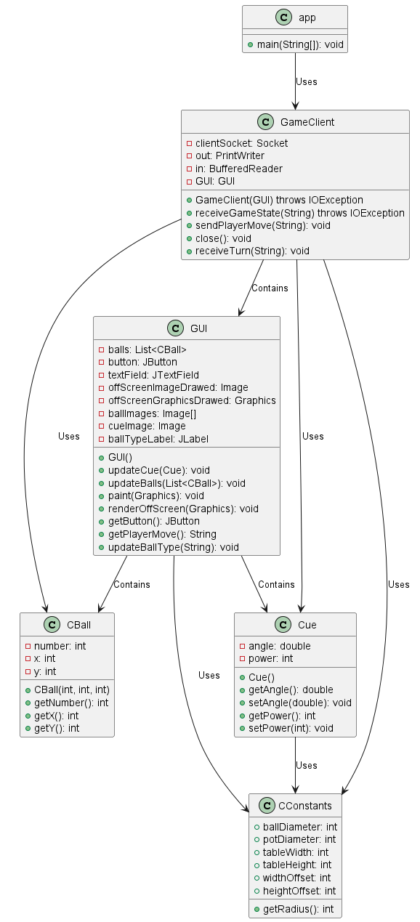
Client TCP Architecture
-The main class is GameClient.java. This class handles the connection to the server and the sending and receiving of messages.
-The connection to the server is established using the TCP protocol, which ensures reliable delivery of messages.
-Sent and received messages are encoded according to a protocol defined in the design, which allows the client and server to understand commands and game updates.
-When a message is received from the server, GameClient.java updates the game state and user interface based on the message content.
-The game user interface is implemented using Java Swing. This interface allows players to see the current state of the game and send commands to the server.

Slide 4
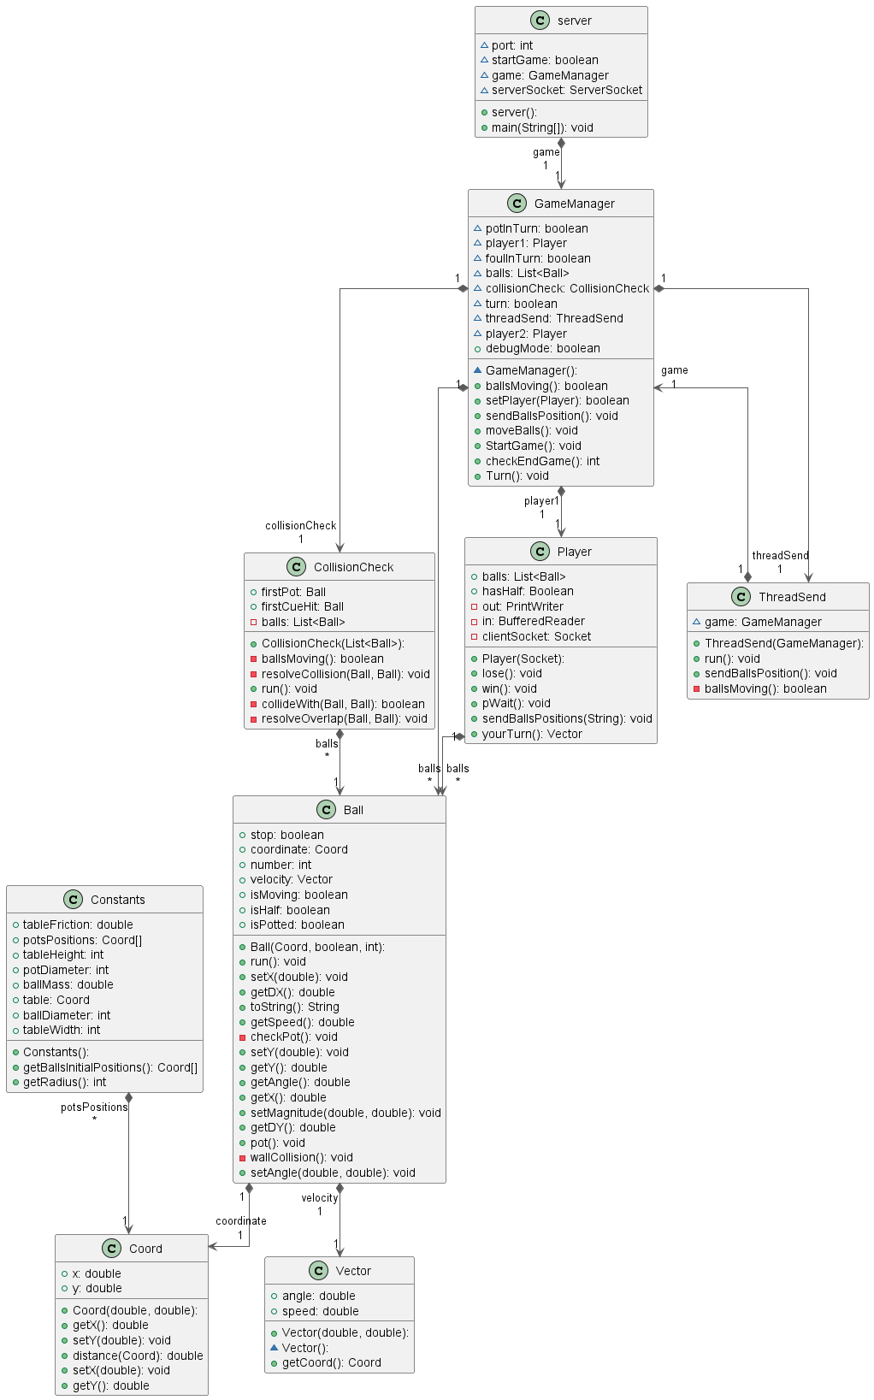
Server TCP Architecture
-The main class is server.java. This class handles client connections and running matches.
-The server accepts connections from clients using the TCP protocol, which ensures reliable delivery of messages.
-When a client connects, the server starts a new game and keeps track of the game state for that game.
-Messages received from clients are interpreted as commands that affect the state of the game. For example, a command might indicate that a player wants to hit a ball.
-After interpreting a command, the server updates the game state accordingly and sends an update message to all connected clients.
-This cycle of receiving commands, updating the game state, and sending updates continues until the game is over.

Slide 5

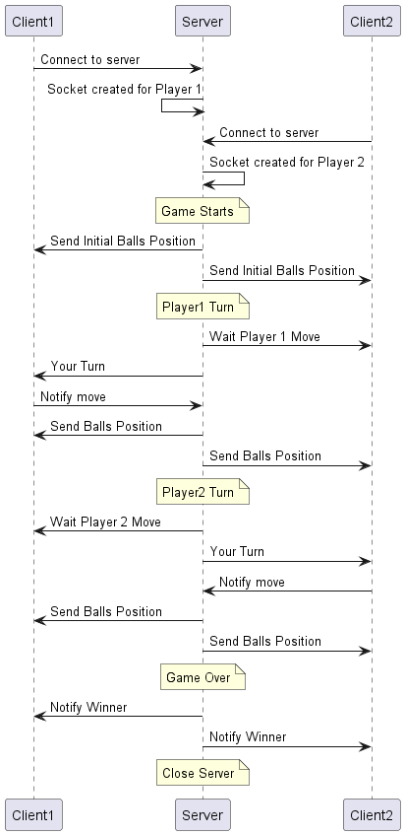
Client-Server Logic
-Client-server communication is based on a messaging protocol defined in the project. This protocol establishes the format and meaning of messages exchanged between client and server.
-Clients send commands to the server to interact with the game. For example, a command might indicate that a player wants to hit a ball.
-The server interprets the commands received from the clients and updates the game state accordingly.
-After updating the game state, the server sends an update message to all connected clients. This message informs the clients of the current state of the game.
-Clients receive the update messages from the server and update their user interface to reflect the current state of the game.
-This cycle of sending commands, updating the game state, and receiving updates continues until the game is over.

Slide 6

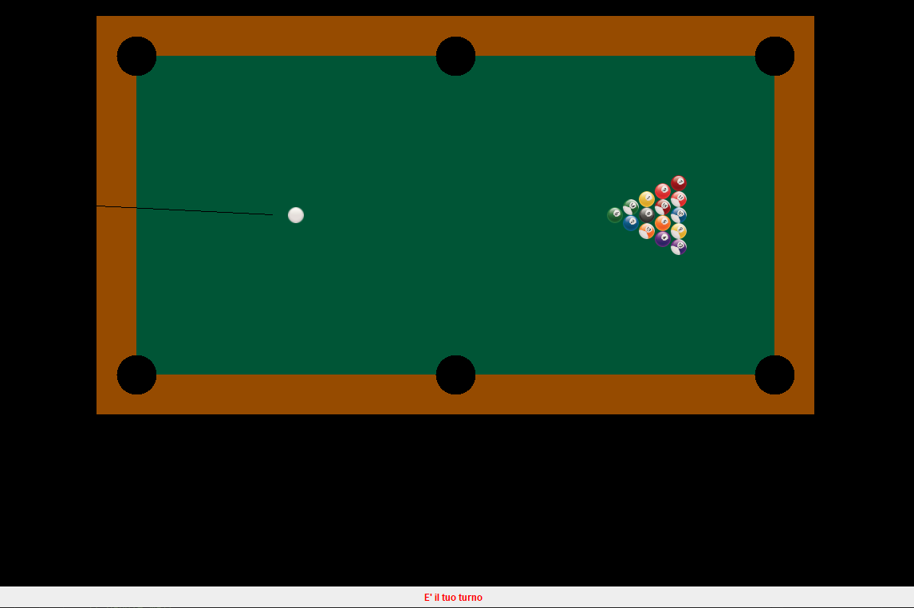
Management of a match
Two clients establish a connection with the server and request to start a new game.
The server starts a new game, initializes the game state (ball position, player turn, etc.) and sends this state to the clients
.The clients receive the game state and display it to the players through the user interface.
Players send commands to the server through the client to interact with the game (e.g., hit a ball).
The server receives the commands, updates the game state based on the physics of the billiards game, and sends the updated state to the clients.
The clients receive the updated game state and update the user interface to reflect the new ball positions and the player's turn.
This process continues until an end-of-game state is reached (e.g., all balls have been bagged), at which point the server notifies clients of the outcome of the game.

Slide 7

END

